Slide 1
EXHAUST VALVE CONSTRUCTION AND WORKING

Slide 2
EXHAUST VALVE CONSTRUCTION
1. Exhaust valve casing
The casing which is made of cast iron contains different components and driving arrangement for the exhaust valve. It also has jackets, through which, colling water passes for maintaining the valve temperature

Slide 3
2. Valve and Spindle
The spindle is responsible to draw the exhaust gasses out from the engine cylinder when operated in an open and closed position. The spindle can be a molybdenum chrome alloy with a layer of stellite, welded onto the seating face, or alternatively, a heat resistant Nimonic alloy valve head, friction welded to an alloy steel shaft. The valve spindle is fitted with a winged valve rotator.

Slide 4
3. Exhaust valve seat
The exhaust valve seat is a renewable valve seat that can be reconditioned or replaced in case of damage and is usually made from hardened molybdenum steel with stellite coating for good temperature resistant property.

Slide 5
4. Valve Face
A ‘Stellite’ layer is welded to provide superior hardness, corrosion resistance, good surface finish, and high-temperature strength. This portion is subjected to very high temperatures and thermal and mechanical stresses.
‘Stellite’: 2C, 50 Co, 20 Cr, 18 Mo, 10 Tungsten

Slide 6
5. Valve Guide
‘Pearlite’ Cast Iron.
6. Valve Cotter
A pair of valve cotter is used to lock the Valve stem with a spring retainer and ensures smooth functioning of the engine.

Slide 7
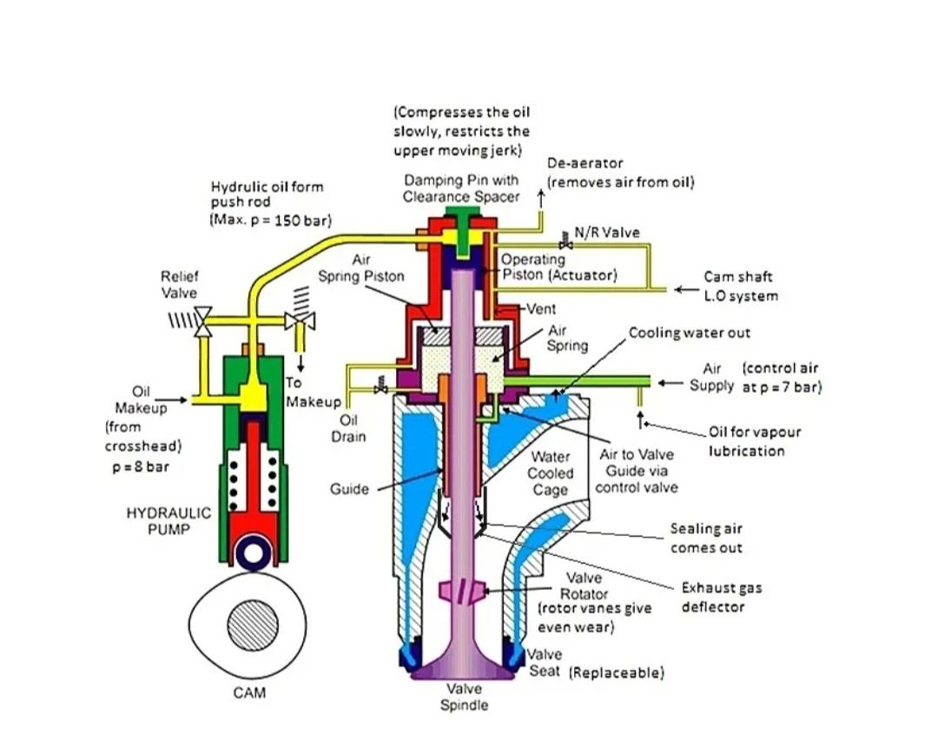

Slide 8
2. EXHAUST VALVE WORKIGN
The camshaft of the exhaust valve is connected to the crankshaft via chains or gears. Once the cam is in the cam profile, the hydraulic oil pump will overcome the spring force and the oil will be delivered to the exhaust valve at high pressure.
The pressure at which the hydraulic oil operates the exhaust valve can go up to 150 – 220 bars.

Slide 9
Hydraulic oil chamber and the operating piston is on the top of the valve spindle.
As the hydraulic oil pushes the operating piston, which is connected to the valve spindle, the valve will move down and allow the exhaust inside the cylinder to flow out of the engine to exhaust trunk.

Slide 10
There is a spring air piston chamber which has an air supply connection. As the valve opens, the air underneath the piston is compressed. The expansion of this compressed air, when the hydraulic pressure is relieved assists in the closing of the valve.
The air is supplied with a small amount of oil for lubrication purposes. Air is also led down the exhaust valve guide. This keeps the guide cool and lubricated and prevents the exhaust gas leaking up the guide.

Slide 11
The kinetic energy in the exhaust gas rotates the valve because of winged valve rotator, which keeps the valve at an even temperature and helps reduce the build-up of deposits on the valve seat.
Once the hydraulic oil pump roller comes off the cam profile, into the cam circle, the spring pressure will cut the supply of the hydraulic oil. Now the air supply, under the spring air piston, will close the valve and seal it with the valve seat, stopping the flow of the exhaust out of the cylinder. The air pressure is approx. 7 bar to close the valve.

Slide 12
The oil remaining in the hydraulic oil chamber is taken out from the drain valve when the valve is closing due to air pressure.
To prevent the possibility of an air lock, the hydraulic system has a small leak off at the top of the exhaust valve hydraulic cylinder. Oil is made up via a non-return valve. A relief valve is also fitted.
A damping arrangement on top of the piston in the exhaust valve prevents hammering of the valve seating.

Slide 13
In most of the modern engine, air pressure is used to close the valve. However, in some old engines, spring was used instead of air pressure to close the valve. (Note: In auxiliary engines a pair of springs is used).
The overhauling period of Main engine exhaust valve depends on the maker and type of exhaust valve. However, in the modern marine engine, the interval can go up to 36000 hours; post that, the valve will need an overhaul.

Slide 14
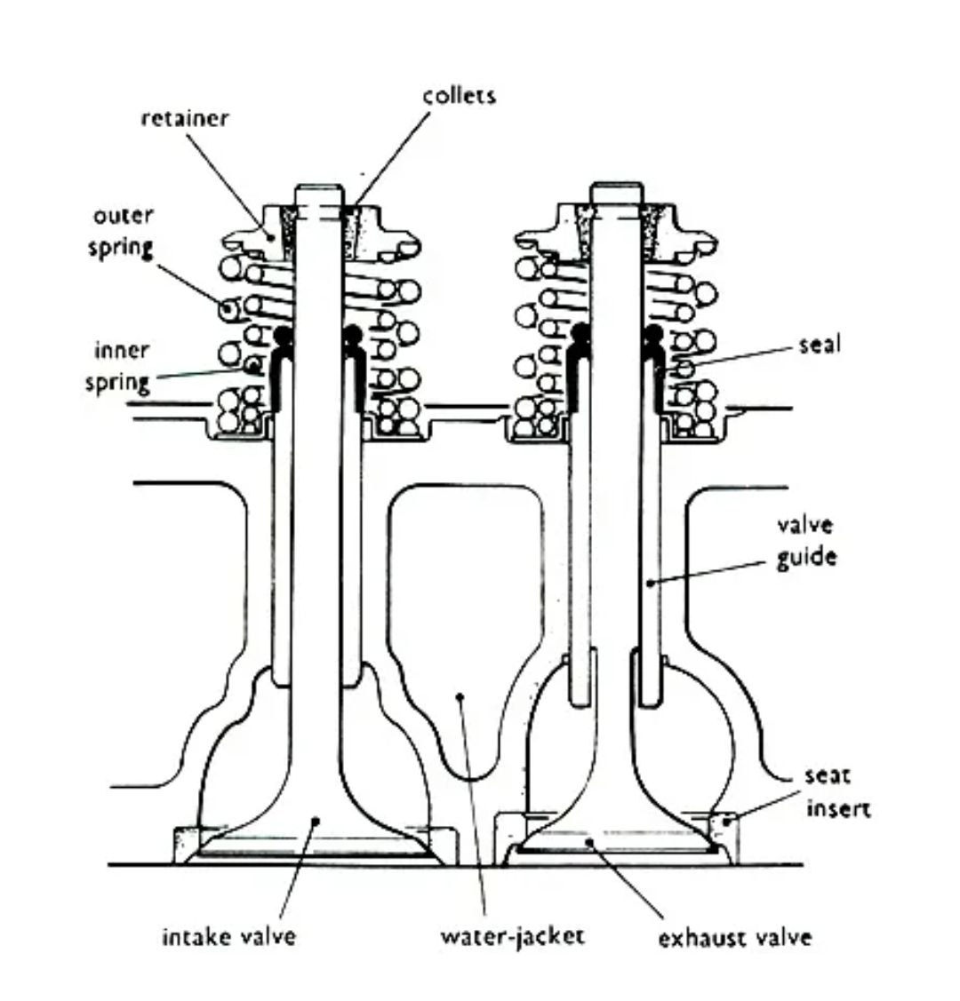
EXHASUT AND INLET VALVES IN AUXILIARY ENGINES

Slide 15
3. EXHAUST VALVE OPERATION IN ELECTRONIC ENGINES
The exhaust valve actuator replaces the cam operated exhaust valve hydraulic pump on both make of camshaft-less engines.
Both working on a similar principle, servo oil at 200 bar is used to operate a piston which operates the exhaust valve “hydraulic push rod” The oil for operating the “hydraulic push rod” comes from the main engine LO supply via a non-return valve.

Slide 16
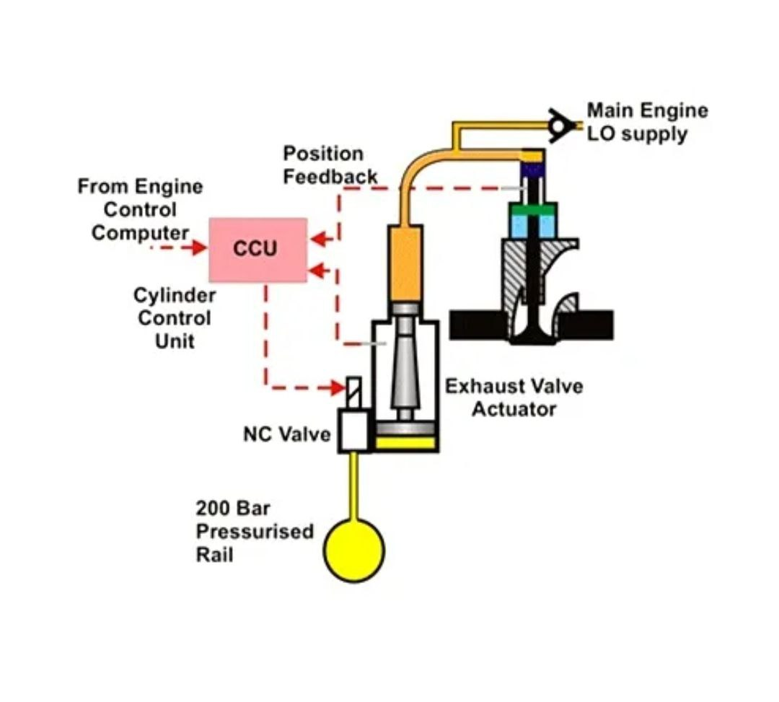

Slide 17
4. VARIABLE EXHAUST VALVE CLOSING
In this system the valve closing timing is altered without disturbing the lift of the valve.
This is done to optimize the exhaust valve operation over the normal load range, where the closing point of the exhaust valve is changed over 70-85% of MCR.
During Variable Exhaust Closing operation if the exhaust valve is closed early, it means that the compression stroke of the piston is increased. This will lead to higher compression pressures and temperatures.

